Slide 1
Object Tracking Robot
ViSION Project Exhibition 2019
Project Guide: Mr. Rohit Kumar
Group Members:
Gaurav Nemade
Nihar More
Prajakta Gharat
Piyush Patil

Slide 2
PROBLEM STATEMENT
The major drawback faced by modern surveillance devices is it need human assistance which is easily distracted so we need a device which can autonomously monitor the surrounding

Slide 3
AGENDA
Introduction
Project Overview
Technology used
Prototype
Conclusion
References

Slide 4
INTRODUCTION
We made this project as a basic prototype for a bot which can sense colour shape and size of an object and distinguish between various features of the object
Basically this project focuses on tracking a ball by using camera to take frames and do image processing to track it down by using its size, shape, and colour.

Slide 5
PROJECT OVERVIEW
Here we've used Raspberry pi as micro controller as it supports Raspberry pi camera module and Python as coding language, we used OpenCV library for image analysis.
We used H-Bridge to control the motor and direction and speech in different situations are controlled via code.

Slide 6
TECHNOLOGY USED
Sr. No. | Name of Component | Specification | Qty
1 | Raspberry Pi | 2 Model B | 1
2 | Raspberry Pi Camera Module | 5 MP | 1
3 | Arduino Ultrasonic Sensor | - | 3
4 | Dual H-Bridge Motor Driver | L298 | 2
5 | DC Motor | - | 2
6 | Breadboard | - | 1
7 | Connecting Wires | - | -

Slide 7
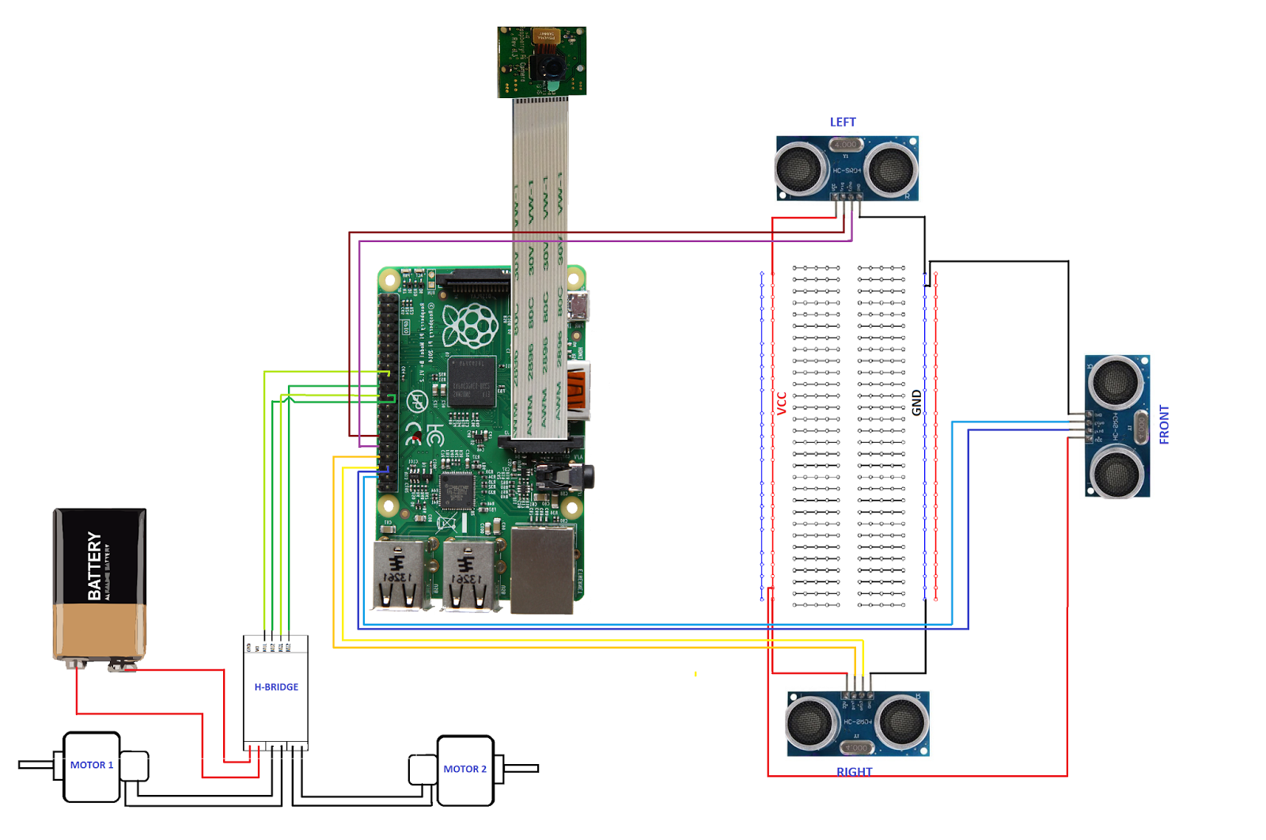
Circuit Diagram

Slide 8
FLOW CHART
Raspberry Pi Initialization
Pi
Camera
Red circular
object detected
IF
IF
Object not
detected
Via OpenCV and
ML Image Processing
Object is tracked and followed
Command to the bot
to rotate 360°
Ultrasonic to not to
collide with the object and
detect any other obstacle
and avoid it

Slide 9
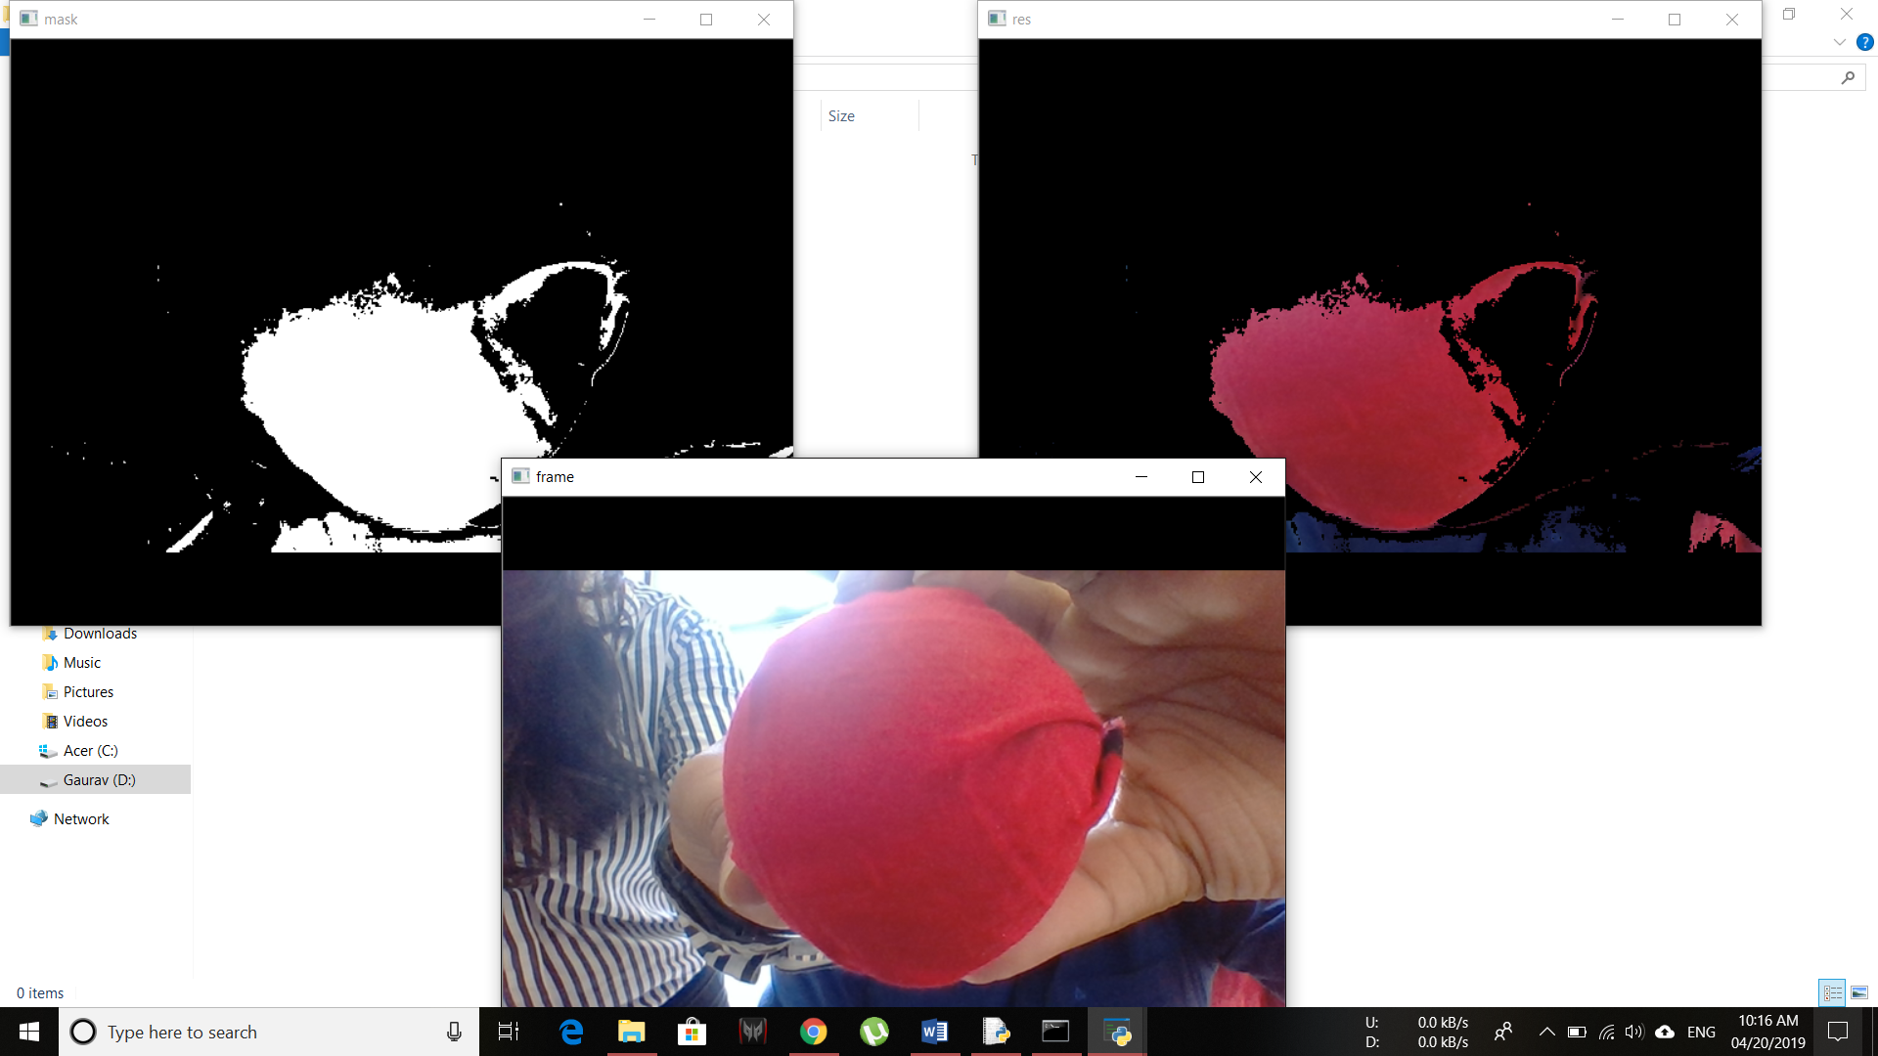

Slide 10
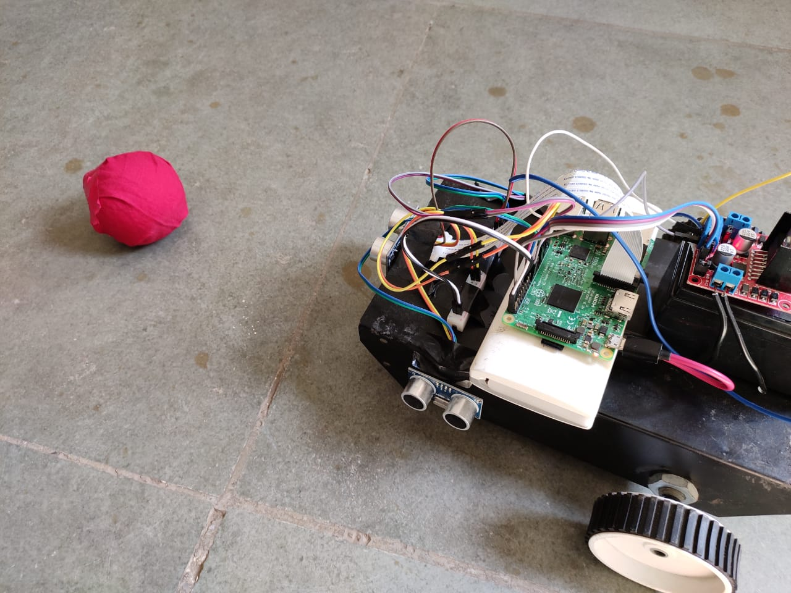
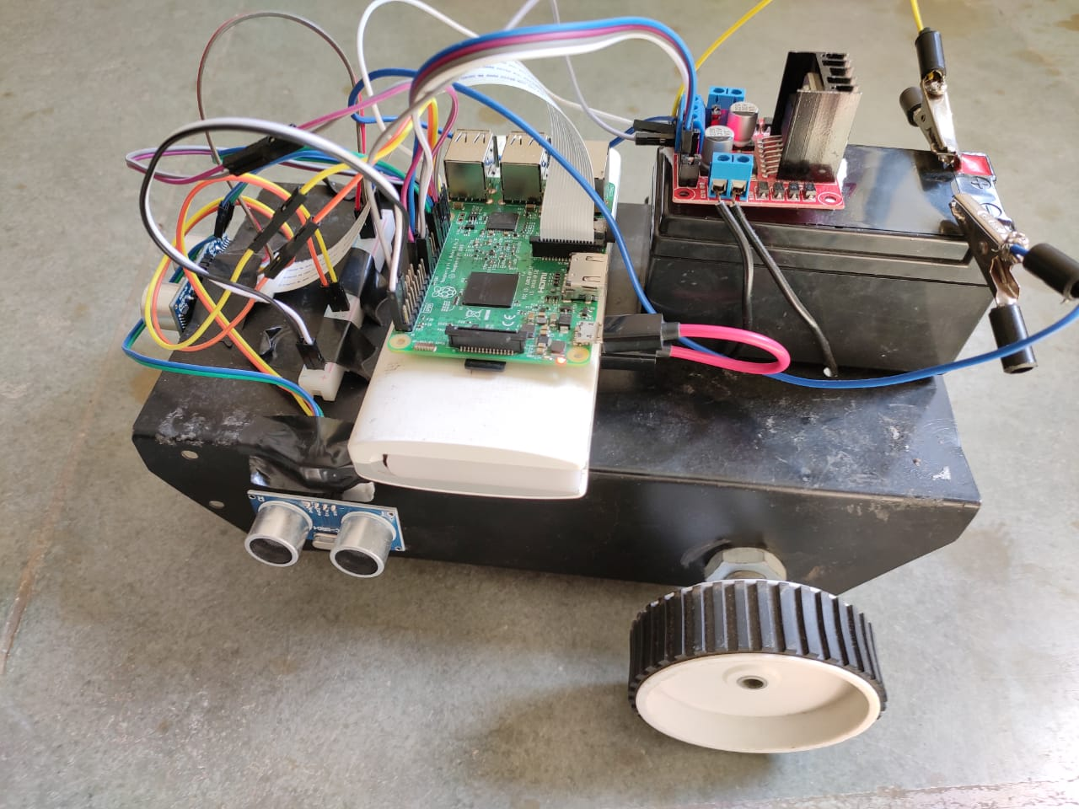
PROTOTYPE

Slide 11
ADVANTAGES
No human controlling is needed.
Specific objects can be tracked.
Better surveillance.

Slide 12
APPLICATIONS
Autonomous surveillance.
Can be used as child monitoring system.
Can work as a spy.
Person following Suitcase/Drone/Robot.
Pet/Wildlife tracker.
Robot Pet.

Slide 13
CONCLUSION
This device can be an excellent and hassle free replacement for our regular surveillance system which is only restricted to one specific area.

Slide 14
BIBLIOGRAPHY
Md.Al-Masrur Khan, Ahmadun Nabi, Abdullah-Al Nahid, Younus Ali, "Temperature Sensed Obstacle Avoiding Robot *", Electrical Computer and Communication Engineering (ECCE) 2019 International Conference on, pp. 1-6, 2019.
Park, J.-W., Park, J.-H., Yun, K.-S., Lee, J.-M.: Tracking and Capturing a Moving Object Using Active Camera Mounted on a Mobile Robot. The Institute of Control, Robotics and Systems 7(9) (September 2001)
Jin, T.-S., Lee, J.-M.: Object Position Estimation and Optimal Moving Planning of Mobile Manipulator based on Active Camera. The Institute of Electronics Engineers of Korea 42(5), 1–12 (2005)

Slide 15
THANK YOU

